Slide 1

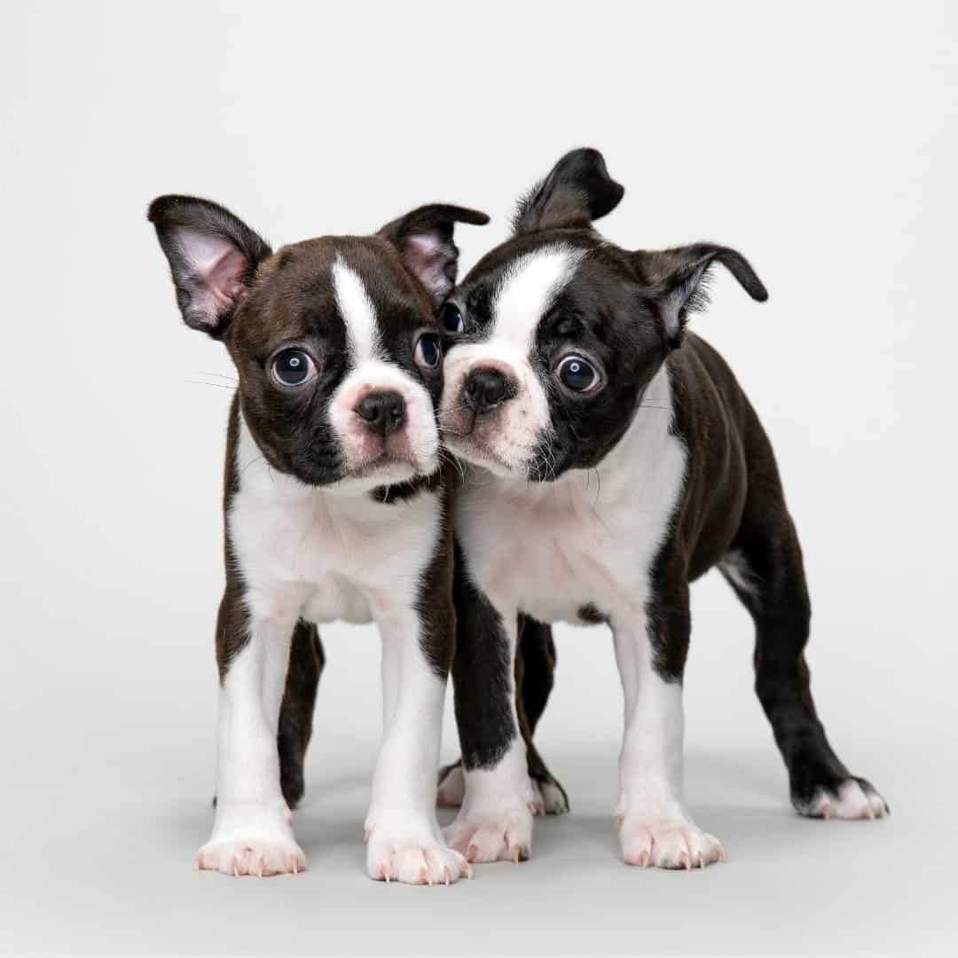

Capstone Project Phase B Project No. 24-1-R-15 Research on Dog - Human Communication Using Eye Tracker Technology
Supervisors:
Dr. Julia Sheidin
Dr. Samah Idrees-Ghazawi
Student:
Sara Asaad
23.09.2024

Slide 2

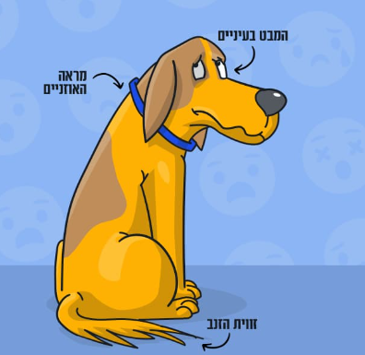
Research Questions
Does focusing on specific parts of the dog's face may aid in understanding its emotions?
Which parts of the dog's body or face (normocephalic or brachycephalic dog) provide more information for recognizing emotions?
How can eye tracking technology contribute to a better understanding of dogs and strengthen the connection between humans and dogs?

Slide 3

Motivation
Relationship between humans and dogs.
Importance of understanding dogs' emotions.
Challenges in understanding dog behavior and facial expressions.

Slide 4

Previous Work
Connected to the study of the Czechs with Prof. Anna Zamansky.
Research subject - human perception of visual communication in brachycephalic vs. normocephalic dogs.
Our research is a collaboration between Braude College, the University of Haifa, and the University of Czech Life Sciences in Prague.

Slide 5
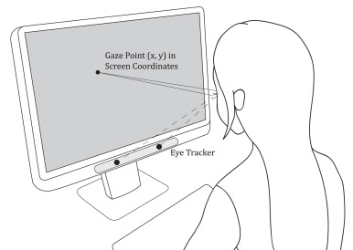
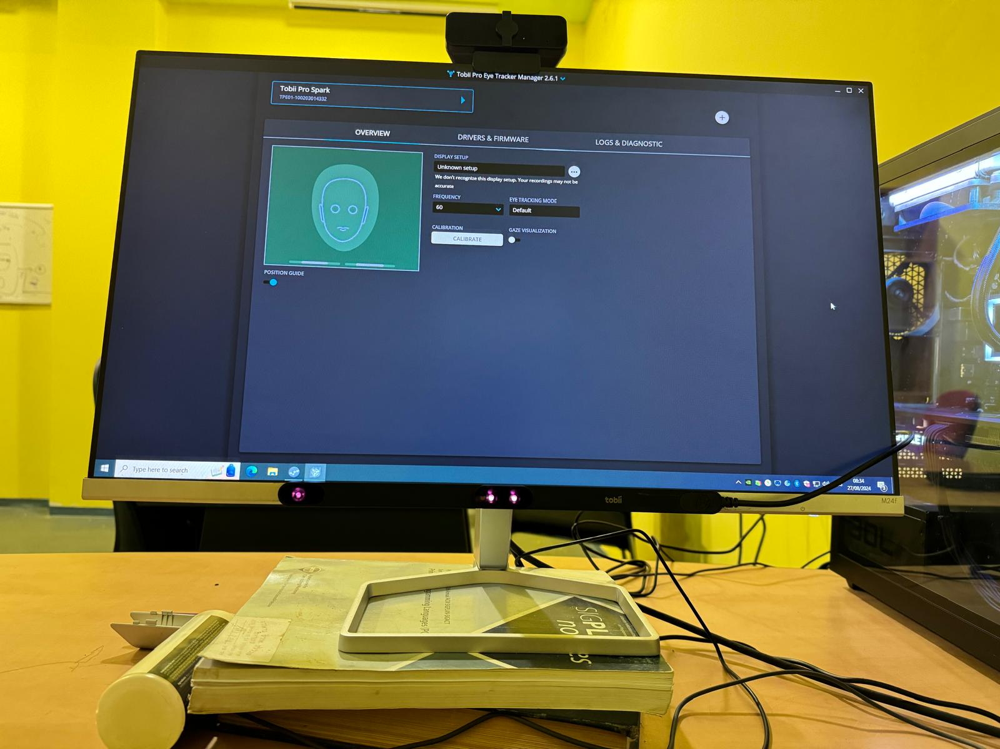
Novelty: Eye Tracking Technology
This technology converts eye movements into a data stream containing information like gaze point, visit number, or time.
In our experiment, we used Tobii Pro Lab system eye tracking.

Slide 6
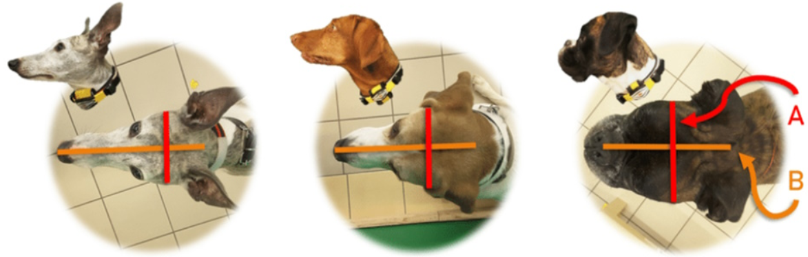
Brachycephalic vs. Normocephalic
Brachycephalia means ‘shortened head’ syndrome.
Brachycephalic dogs will also appear with short noses.
This syndrome refers to a particular set of airway abnormalities.

Slide 7
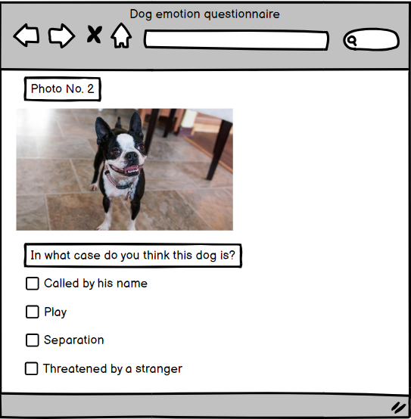
Research Methodology
We conducted an online experiment.
Participants were provided with photos of brachycephalic and normocephalic dogs in various contexts, followed by questions for every photo.
Used both eye-tracking technology and
self-reported data to analyze dogs’
emotional and behavioral responses.

Slide 8

Dataset
Had two breeds images of: brachycephalic and normocephalic dogs.
The source of the images is based on the Czech experiment.
Contained 5 images (for each breed) of dog faces in these situations:
Called the dog by his name.
Play.
Separation.
Threatened by a stranger.

Slide 9
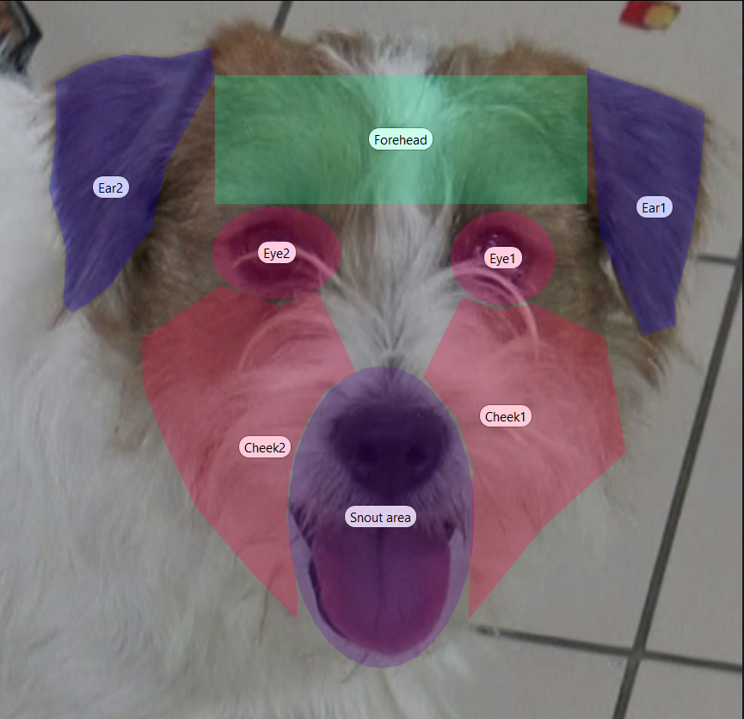
AOI’s (Areas Of Interest)
Refers to specific regions within an image or visual stimulus where participants' attention is measured.
In our study, AOI’s included eyes, ears,
snout area, cheeks, and forehead.

Slide 10

Procedure
45 participants, mostly from Braude College of Engineering, took part in the study, 28 males and 17 females. The average participant age was 23.22 (SD = 4.58 years), 22 of them have a dog, and 23 do not.
Experiments were conducted in a quiet room, VR Lab.
Participants were seated in front of a Full HD screen.
A Tobii Pro Spark eye tracker was used to record eye movements.
Participants viewed dog pictures and identified the dog's situation/emotion.
Data was analyzed.

Slide 11
Our Research Results

Slide 12
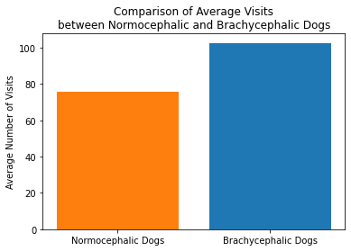
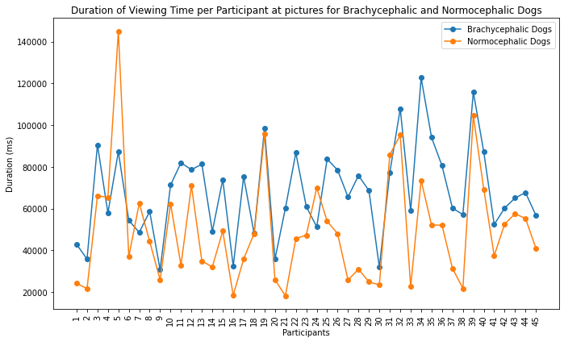
Average Visits and Viewing Time For Both Breeds Images
The average number of visits to images of brachycephalic dogs is 35% higher than the average number of visits to to images of normocephalic dogs.
Participants spent 37% more average time viewing images of brachycephalic dogs than average time viewing images of normocephalic dogs.
Time is measured in milliseconds.
Visits = How many times they looked at the picture.

Slide 13
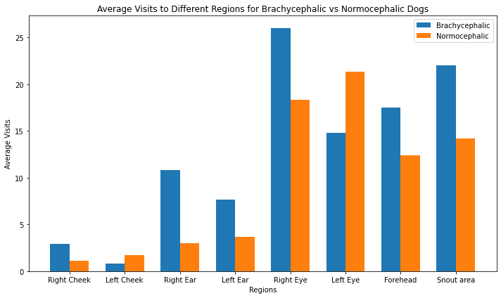
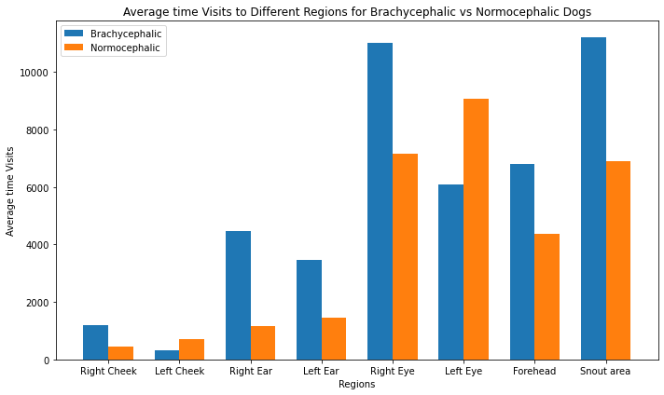
Average Visits and Viewing Time For Both Breeds AOI’s
In almost all areas of interest, participants focused more visits on brachycephalic dogs AOI’s.
The findings indicate that brachycephalic dogs attracted more focus time from the participants in most areas tested.
Visits = How many times they looked at the AOI’s.
Time is measured in milliseconds.

Slide 14
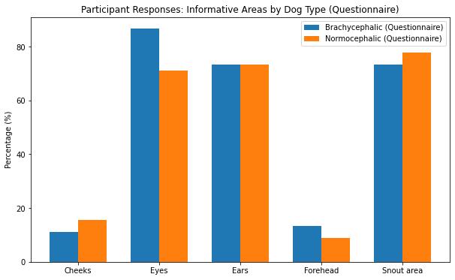
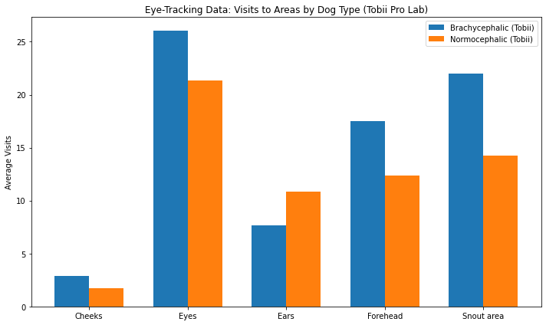
Self-Reports vs. Eye-Tracking Data
Participants reported eyes, snout, and ears as the most informative areas for brachycephalic and normocephalic dogs, but eye-tracking software revealed discrepancies primarily in the snout and ears, indicating potential gaps in self-awareness.

Slide 15
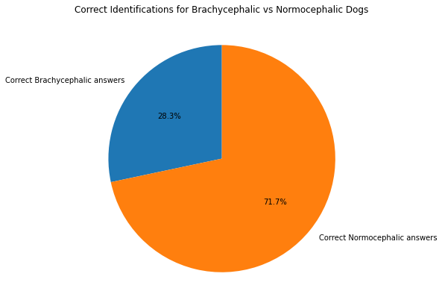
Analysis of the Dog's Situations
Participants correctly identified emotions in normocephalic dog photos (71.68%) and (28.3%) in brachycephalic dog photos, due to physical structure and unique facial features causing confusion or misinterpretation.

Slide 16
Conclusions
Normocephalic dogs were easier to interpret and associated with positive emotions.
Brachycephalic dogs evoked more negative emotions (anger, fear) due to their unique facial features.
Participants focused more on brachycephalic dogs, especially on their eyes and snout.
Facial structure plays a key role in how dog emotions are perceived, with brachycephalic dogs being harder to read.

Slide 17


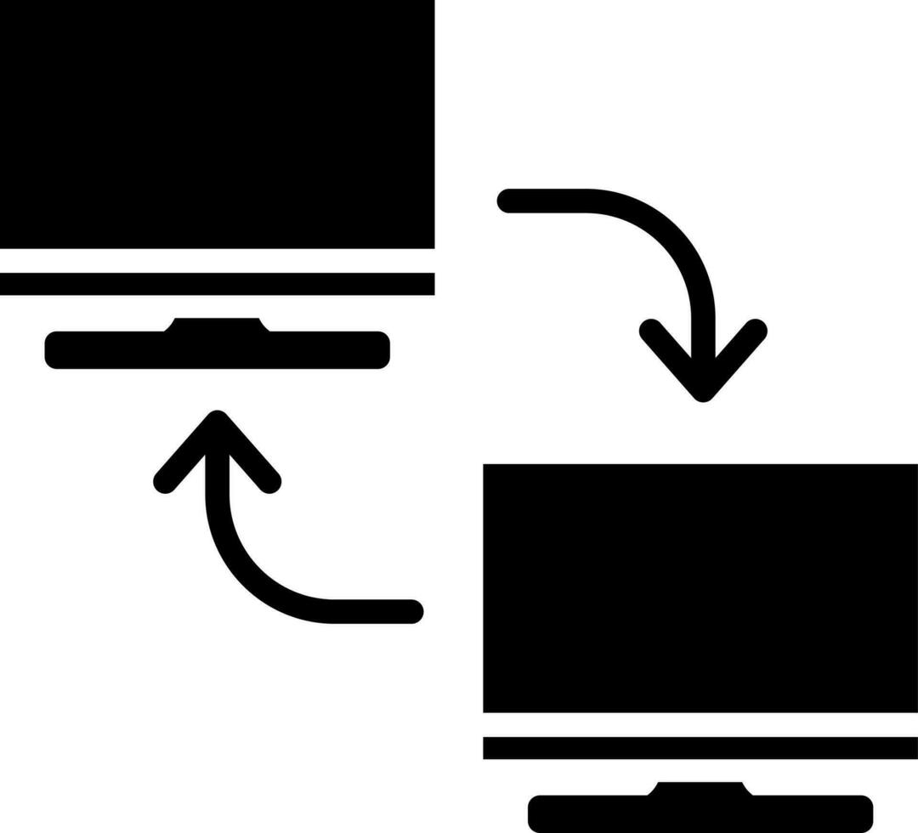


Challenges
Shared License Usage
Project transfer by computers
Software Updates
Technical challenges
Self-Learning of the Software

Slide 18

Future Work
Research Expansion: Flexible system for diverse future experiments.
Adaptability: Easily swap images, questions, or animals.
Scope Broadening: Add videos for dynamic behavior analysis, and more participants.
Collaboration: Interest from Prague and Haifa, potential for more partnerships.

Slide 19

Experimental recording
Experimental recording: A random sample from one of the participants.

Slide 20
References
https://www.bostonterriersociety.com/wp-content/uploads/2023/01/10-1024x1024.jpg
https://cdn.shopify.com/s/files/1/0589/6768/7343/files/Blue_Boston_Terrier_being_held_by_a_person_licking_its_nose_with_a_playful_and_engaging_demeanor..png?v=1706753146
https://media.springernature.com/full/springer-static/image/art%3A10.1038%2Fs41598-021-88702-w/MediaObjects/41598_2021_88702_Fig1_HTML.png
https://chayuta.com/assets/uploads/2023/09/Artboard-192-copy.jpg
https://theonlinedogtrainer.com/wp-content/uploads/2023/07/image_4cfb3280e0846a7e9b3f6d0913b04668_2000.png
Eretová, P., Liu, Q., Přibylová, L., Chaloupková, H., Bakos, V., Lenkei, R., & Pongrácz, P. (2024). Can my human read my flat face? The curious case of understanding the contextual cues of extremely brachycephalic dogs. Applied Animal Behaviour Science, 270, 106134.‏
Liu, W., Trapp, A. C., & Djamasbi, S. (2021). Outlier-Aware, density-Based gaze fixation identification. Omega, 102, 102298.‏
Bloom, T., & Friedman, H. (2013). Classifying dogs’(Canis familiaris) facial expressions from photographs. Behavioural processes, 96, 1-10.‏
Guo, K., & Shaw, H. (2015). Face in profile view reduces perceived facial expression intensity: an eye-tracking study. Acta psychologica, 155, 19-28.
Sæther, L., Van Belle, W., Laeng, B., Brennen, T., & Øvervoll, M. (2009). Anchoring gaze when categorizing faces’ sex: evidence from eye-tracking data. Vision research, 49(23), 2870-2880.

Slide 21


THANKS FOR YOUR LISTENING
Now I am ready to answer your questions.

